Slide 1
The TCP Connection Establishment
To establish a connection, one side, say, the server, passively waits for an incoming connection by executing the LISTEN and ACCEPT primitives, either specifying a specific source or nobody in particular.
The client, executes a CONNECT primitive, specifying the IP address and port to which it wants to connect, the maximum TCP segment size it is willing to accept, and optionally some user data (e.g., a password). The CONNECT primitive sends a TCP segment with the SYN bit on and ACK bit off and waits for a response.
When this segment arrives at the destination, the TCP entity there checks to see if there is a process that has done a LISTEN on the port given in the Destination port field. If not, it sends a reply with the RST bit on to reject the connection.
If some process is listening to the port, that process is given the incoming TCP segment. It can then either accept or reject the connection. If it accepts, an acknowledgement segment is sent back. The sequence of TCP segments sent in the normal case.
The SYN segment consumes 1 byte of sequence space so that it can be acknowledged unambiguously.

Slide 2
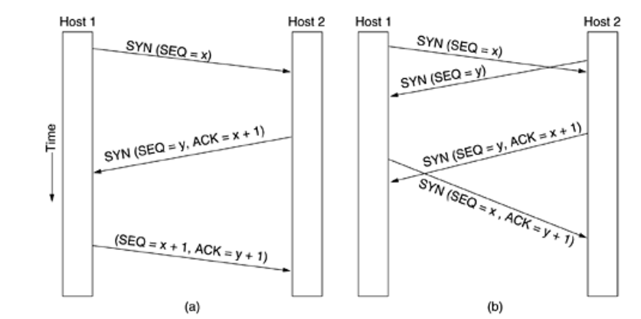
The TCP Connection Establishment
In the event that two hosts simultaneously attempt to establish a connection between the same two sockets, the sequence of events is shown in Fig. b.
The result of these events is that just one connection is established, not two because connections are identified by their end points. If the first setup results in a connection identified by (x, y) and the second one does too, only one table entry is made, namely, for (x, y).
The initial sequence number on a connection is not 0 for the reasons we discussed earlier. A clock-based scheme is used, with a clock tick every 4 μsec.
For additional safety, when a host crashes, it may not reboot for the maximum packet lifetime to make sure that no packets fro previous connections are still roaming around the Internet somewhere.

Slide 3
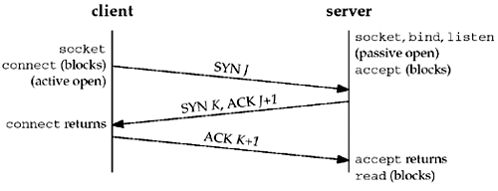
The TCP Connection Establishment
Active Open: The address and port must both be specified, because TCP/IP cannot actively initiate a connection without knowing the destination address and port.
Passive Open: If your program is offering a service to anyone who wants it, specify an address of UNSPECIFIEDaddress and a port of UNSPECIFIEDport.
TCP's Three-way handshake:
The server must be prepared to accept an incoming connection. Achieved using socket, bind and listen (passive open).
The client issues an active open by calling connect. This causes' the client TCP to send a synchronize (SYN) segment. It tells the server the clients initial Sqno for the data that the client will send on the connection. (IP header, TCP header and possible TCP options.
The server sends its SYN and the ACK of the client’s SYN in a single segment.
The client must acknowledge the Server’s SYN.

Slide 4
The TCP Connection Release
Each simplex connection is released independently of its sibling. To release a connection, either party can send a TCP segment with the FIN bit set, which means that it has no more data to transmit.
When the FIN is acknowledged, that direction is shut down for new data. Data may continue to flow indefinitely in the other direction.
When both directions have been shut down, the connection is released. Normally, four TCP segments are needed to release a connection, one FIN and one ACK for each direction.
However, it is possible for the first ACK and the second FIN to be contained in the same segment, reducing the total count to three.
Just as with telephone calls in which both people say goodbye and hang up the phone simultaneously, both ends of a TCP connection may send FIN segments at the same time.
These are each acknowledged in the usual way, and the connection is shut down. There is, in fact, no essential difference between the two hosts releasing sequentially or simultaneously.

Slide 5
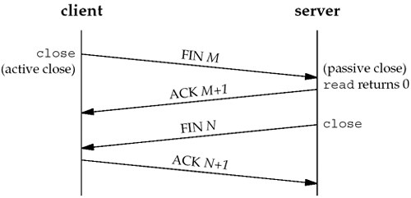
The TCP Connection Release
To avoid the two-army problem, timers are used. If a response to a FIN is not forthcoming within two maximum packet lifetimes, the sender of the FIN releases the connection. The other side will eventually notice that nobody seems to be listening to it any more and will time out as well.
One application calls close first, and we say that this end performs the active close. This end's TCP sends a FIN segment, which means it is finished sending data.
The other end that receives the FIN performs the passive close. The received FIN is acknowledged by TCP. The receipt of the FIN is also passed to the application as an end-of-file.
Sometime later, the application that received the end-of-file will close its socket. This causes its TCP to send a FIN.
The TCP on the system that receives this final FIN (the end that did the active close) acknowledges the FIN.

Slide 6
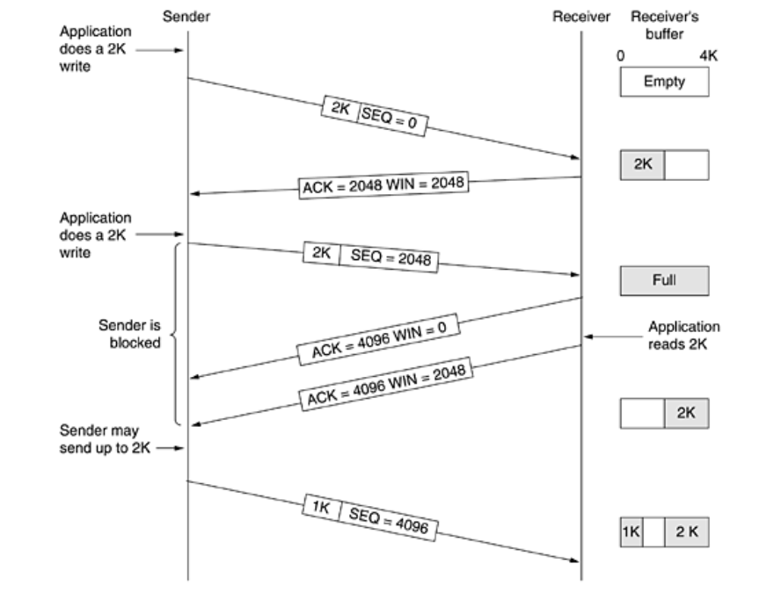
TCP Transmission policy
Suppose the receiver has a 4096-byte buffer, as shown in Figure If the sender transmits a 2048-byte segment that is correctly received, the receiver will acknowledge the segment.
However, since it now has only 2048 bytes of buffer space (until the application removes some data from the buffer), it will advertise a window of 2048 starting at the next byte expected.

Slide 7
TCP Transmission policy
The sender transmits another 2048 bytes, which are acknowledged, but the advertised window is 0. The sender must stop until the application process on the receiving host has removed some data from the buffer, at which time TCP can advertise a larger window.
When the window is 0, the sender may not normally send segments, with two exceptions. First, urgent data may be sent, for example, to allow the user to kill the process running on the remote machine. Second, the sender may send a 1-byte segment to make the receiver reannounce the next byte expected and window size.
The TCP standard explicitly provides this option to prevent deadlock if a window announcement ever gets lost.
Senders are not required to transmit data as soon as they come in from the application. Neither are receivers required to send acknowledgements as soon as possible.
When the first 2 KB of data came in, TCP, knowing that it had a 4-KB window available, would have been completely correct in just buffering the data until another 2 KB came in, to be able to transmit a segment with a 4-KB payload. This freedom can be exploited to improve performance.

Slide 8
TCP Transmission policy
Consider a telnet connection to an interactive editor that reacts on every keystroke. In the worst case, when a character arrives at the sending TCP entity, TCP creates a 21-byte segment, which it gives to IP to send as a 41-byte IP datagram.
At the receiving side, TCP immediately sends a 40-byte acknowledgement (20 bytes of TCP header and 20 bytes of IP header).
When the editor has read the byte, TCP sends a window update, moving the window 1 byte to the right. This packet is also 40 bytes. Finally, when the editor has processed the character, it echoes the character as a 41-byte packet.
In all, 162 bytes of bandwidth are used and four segments are sent for each character typed. When bandwidth is scarce, this method of doing business is not desirable.
One approach that many TCP implementations use to optimize this situation is to delay acknowledgements and window updates for 500 msec in the hope of acquiring some data on which to hitch a free ride.
Assuming the editor echoes within 500 msec, only one 41-byte packet now need be sent back to the remote user, cutting the packet count and bandwidth usage in half.

Slide 9
TCP Transmission policy
This rule reduces the load placed on the network by the receiver, the sender is still operating inefficiently by sending 41-byte packets containing 1 byte of data.
Nagle's algorithm.
Nagels algoritm is designed to improve network efficiency by reducing the number of small packets sent over a network. It is named after its creator, John Nagel.
The algorithm addresses the inefficiencies that arise from sending small packets, which can lead to network congestion and increased overhead.
When data come into the sender one byte at a time, just send the first byte and buffer all the rest until the outstanding byte is acknowledged. Then send all the buffered characters in one TCP segment and start buffering again until they are all acknowledged.
Reduce Small Packets: Nagel’s Algorithm is aimed at reducing the overhead of sending numerous small packets by combining them into a single packet. This can help reduce congestion and improve network throughput.
Optimize Data Transmission: It tries to optimize data transmission by delaying the sending of small packets to aggregate them into larger packets, thus making the transmission more efficient.

Slide 10
TCP Transmission policy
How It Works:
Delayed Acknowledgments: When a sender has data to transmit, the algorithm may delay sending small packets until it can combine them with additional data or until the previous data has been acknowledged. This delay is controlled by the algorithm and is meant to ensure that packets are not sent unnecessarily.
Waiting for Acknowledgments: The sender may hold back small packets until it receives an acknowledgment for previously sent packets.
This is done to ensure that the network is not overwhelmed by too many small packets and to optimize the usage of the available bandwidth.
It helps improve network efficiency but may introduce some latency due to its buffering and delay mechanisms.
:

Slide 11
TCP Transmission policy
TCP performance silly window syndrome Problem :
Silly Window Syndrome is a performance issue in TCP communications that arises due to inefficient data transfer caused by small window sizes.
It leads to excessive small packets and overhead, reducing network efficiency. Solutions like Nagle’s Algorithm, effective buffer management, and application-level optimizations can help mitigate the effects of Silly Window Syndrome and improve the efficiency of TCP connections.
This problem occurs when data are passed to the sending TCP entity in large blocks, but an interactive application on the receiving side reads data 1 byte at a time.
The TCP buffer on the receiving side is full and the sender knows this (i.e., has a window of size 0). Then the interactive application reads one character from the TCP stream.

Slide 12
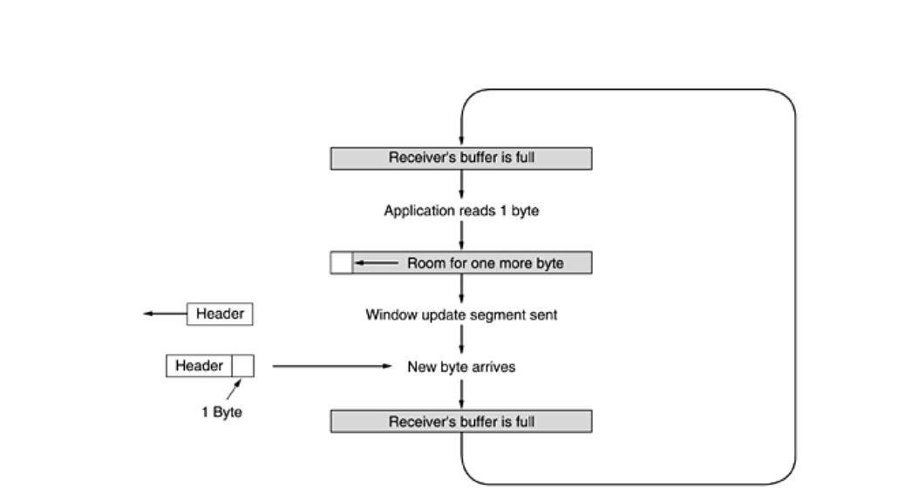
TCP Transmission policy

Slide 13
TCP Transmission policy
This action makes the receiving TCP happy, so it sends a window update to the sender saying that it is all right to send 1 byte. The sender obliges and sends 1 byte.
The buffer is now full, so the receiver acknowledges the 1-byte segment but sets the window to 0. This behavior can go on forever.
Clark's solution is to prevent the receiver from sending a window update for 1 byte. Instead it is forced to wait until it has a decent amount of space available and advertise that instead.
Specifically, the receiver should not send a window update until it can handle the maximum segment size it advertised when the connection was established or until its buffer is half empty, whichever is smaller.
The receiving TCP can go further in improving performance than just doing window updates in large units.
Like the sending TCP, it can also buffer data, so it can block a READ request from the application until it has a large chunk of data to provide.

Slide 14
TCP Transmission policy
This reduces the number of calls to TCP, and hence the overhead. Of course, it also increases the response time, but for non-interactive applications like file transfer, efficiency may be more important than response time to individual requests.
Another receiver issue is what to do with out-of-order segments. They can be kept or discarded, at the receiver's discretion.
Acknowledgements can be sent only when all the data up to the byte acknowledged have been received. If the receiver gets segments 0, 1, 2, 4, 5, 6, and 7, it can acknowledge everything up to and including the last byte in segment 2.
When the sender times out, it then retransmits segment 3. If the receiver has buffered segments 4 through 7, upon receipt of segment 3 it can acknowledge all bytes up to the end of segment 7.

Slide 15
TCP Transmission policy
Solutions to Silly Window Syndrome :
Nagle’s Algorithm:
Nagle’s Algorithm helps mitigate Silly Window Syndrome by reducing the number of small packets sent. It works by delaying the transmission of small packets until more data is available or until an acknowledgment is received, thereby allowing the aggregation of data into larger packets.
TCP Buffer Management:
Delayed Acknowledgments: The receiver can use delayed acknowledgments to wait before sending an acknowledgment, allowing it to accumulate more data and avoid frequent small acknowledgments.
Window Scaling: Modern TCP implementations use window scaling to handle larger window sizes, reducing the chance of small window sizes that contribute to Silly Window Syndrome.
Application-Level Solutions:
Data Aggregation: Applications can be designed to aggregate small data chunks into larger packets before sending them, thereby reducing the frequency of small packet transmissions.
TCP Push Mechanism:
Push Flag: The TCP push flag can be used to indicate that data should be sent immediately rather than being buffered, which can help in some scenarios to avoid small packet transmission.

